Slide 1
OpenJ9 on RISC-V
Cheng Jin (jincheng@ca.ibm.com)
OpenJ9 VM Software Developer, Runtime Technologies
IBM Ottawa Software Lab, Canada

Slide 2


About Us
Joined IBM J9 VM team at Ottawa in 2012
Daily work involves bytecode verifier, JSR292 Method Handle APIs as well as other core components of J9 VM
One of main contributors on the OpenJ9/RISC-V project since 2019
IBM Chief Architect for Java Runtimes
Joined J9 compiler team (Toronto) 2002
Led efforts to refactor J9 JVM to create both Eclipse OMR and Eclipse OpenJ9 open source projects
One of the several project leads for both OMR and OpenJ9

Slide 3
Important Disclaimers & Legal Notice
THE INFORMATION CONTAINED IN THIS PRESENTATION IS PROVIDED FOR INFORMATIONAL PURPOSES ONLY.
IBM AND THE IBM LOGO ARE TRADEMARKS OR REGISTERED TRADEMARKS OF IBM CORPORATION, IN THE UNITED STATES, OTHER COUNTRIES OR BOTH.
JAVA AND ALL JAVA-BASED MARKS, AMONG OTHERS, ARE TRADEMARKS OR REGISTERED TRADEMARKS OF ORACLE IN THE UNITED STATES, OTHER COUNTRIES OR BOTH.
OTHER COMPANY, PRODUCT AND SERVICE NAMES MAY BE TRADEMARKS OR SERVICE MARKS OF OTHERS.
WHILST EFFORTS WERE MADE TO VERIFY THE COMPLETENESS AND ACCURACY OF THE INFORMATION CONTAINED IN THIS PRESENTATION, IT IS PROVIDED “AS IS”, WITHOUT WARRANTY OF ANY KIND, EXPRESS OR IMPLIED.
ALL PERFORMANCE DATA INCLUDED IN THIS PRESENTATION HAVE BEEN GATHERED IN A CONTROLLED ENVIRONMENT. YOUR OWN TEST RESULTS MAY VARY BASED ON HARDWARE, SOFTWARE OR INFRASTRUCTURE DIFFERENCES.
ALL DATA INCLUDED IN THIS PRESENTATION ARE MEANT TO BE USED ONLY AS A GUIDE.
IN ADDITION, THE INFORMATION CONTAINED IN THIS PRESENTATION IS BASED ON IBM’S CURRENT PRODUCT PLANS AND STRATEGY, WHICH ARE SUBJECT TO CHANGE BY IBM, WITHOUT NOTICE.
IBM AND ITS AFFILIATED COMPANIES SHALL NOT BE RESPONSIBLE FOR ANY DAMAGES ARISING OUT OF THE USE OF, OR OTHERWISE RELATED TO, THIS PRESENTATION OR ANY OTHER DOCUMENTATION.
NOTHING CONTAINED IN THIS PRESENTATION IS INTENDED TO, OR SHALL HAVE THE EFFECT OF:
CREATING ANY WARRANT OR REPRESENTATION FROM IBM, ITS AFFILIATED COMPANIES OR ITS OR THEIR SUPPLIERS AND/OR LICENSORS

Slide 4
Agenda
Introduction to OpenJ9
Work on RISC-V

Slide 5


What is OpenJ9?
OpenJDK
OpenJDK/OpenJ9
Open JDK
Open JDK
HotSpot
OMR
OpenJDK (https://github.com/ibmruntimes/openj9-openjdk-jdk11): Building framework/Java Class libraries)
Eclipse OpenJ9 (https://github.com/eclipse/openj9): Java Virtual Machine Core (equivalent of Hotspot)
Eclipse OMR (https://github.com/eclipse/omr): Reusable runtime components underpinning OpenJ9

Slide 6
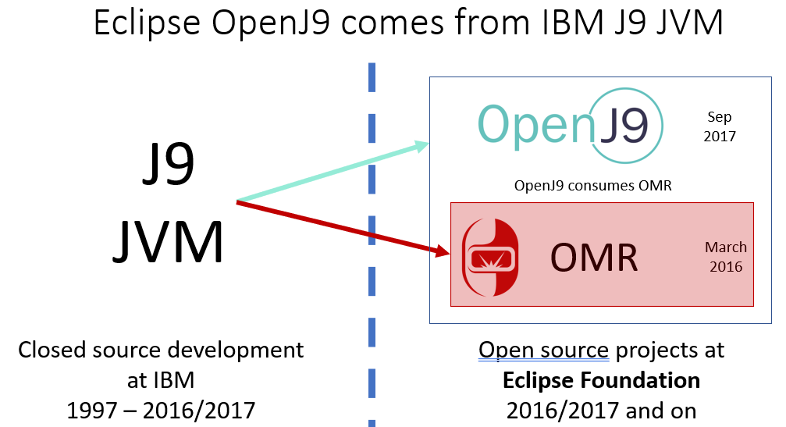
A Brief History of OpenJ9
J9 VM developed independently by IBM (originally in the embedded world) as Enterprise middleware over 20 years (small footprint, fast startup & high performance)
Donated to the Eclipse Foundation in 2017 as Eclipse OpenJ9 (more innovations in collaboration with the open source community)
Dual License: Eclipse Public License v2.0 & Apache v2.0
https://en.wikipedia.org/wiki/OpenJ9

Slide 7
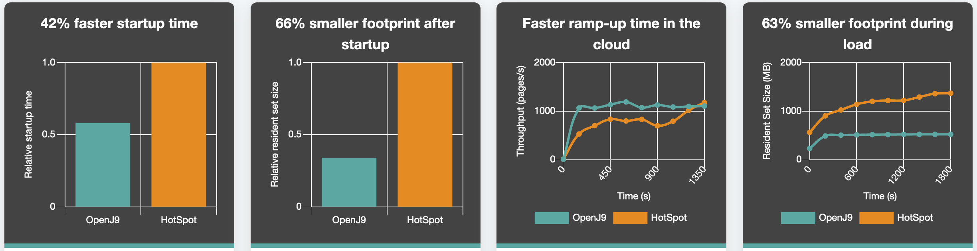
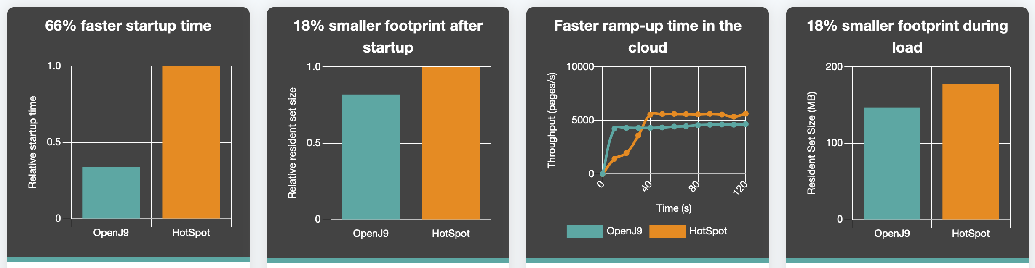
Why OpenJ9?
JDK 8 Performance
Long term focus on start-up time using “dynamic AOT” and shared class cache technologies
Long term focus on efficient memory use
Competitive performance with Hotspot on most workloads
Some really useful diagnostics:
Javacore, -Xdump, -Xtrace, -Xlog, verbose GC and JIT logs, DDR
Single source code base across all active JDK releases
Develop features once, fix bugs once, continually enhance it
Other cool innovations: JIT servers, support for CUDA, investigating snapshot-restore
JDK 11 Performance

Slide 8

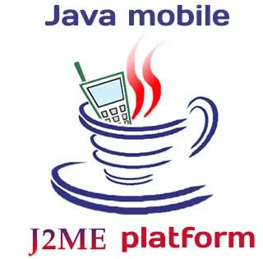




IBM J9
Where is OpenJ9 used?

Slide 9
What is OpenJ9? (Cont.)
The Architecture of OpenJ9 VM
OpenJ9 VM
Classloader
Verification
JCL natives
Interpreter
OpenJ9 RAS & DDR
OpenJ9 GC
OpenJ9 JIT/AOT
SCC
OMR RAS/DDR
OMR GC
OMR Compiler
Thread /Port Library
OMR
Direct Dump Reader (DDR): diagnose issues of OpenJ9 in Java stacktraces at the bytecode level
https://www.slideshare.net/Dev_Events/secrets-of-building-a-debuggable-runtime-learn-how-language-implementors-solve-your-runtime-issues
Shared Classes Cache (SCC): store J9 ROM Classes & AOT code for better performance (startup time, footprint, etc)
https://developer.ibm.com/technologies/java/tutorials/j-class-sharing-openj9/

Slide 10
Part II
OpenJ9 for RISC-V

Slide 11
Porting OpenJ9 JDK to RISC-V (1)
Preparation of Software
Toolchain for cross-compilation
RISC-V GNU Compiler Toolchain at https://github.com/riscv/riscv-gnu-toolchain (compiled from source)
Emulator on the Host system
RISC-V QEMU (riscv64) > 5.0 at https://www.qemu.org/ (compiled from source)
The building instruction at https://wiki.qemu.org/Documentation/Platforms/RISCV/
Linux-based Host System
Ubuntu v19 (Fedora v32, Debian v10, etc)
Linux-based Target System (https://github.com/riscv/riscv-software-list)
64 bit Fedora/RISC-V at https://dl.fedoraproject.org/pub/alt/risc-v/repo/virt-builder-images/images/
64 bit Debian/RISC-V at https://github.com/janvrany/riscv-debian (customized to HiFive U540)

Slide 12
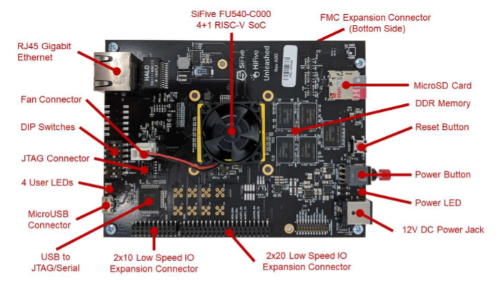
Porting OpenJ9 JDK to RISC-V (2)
Preparation of Hardware
HiFive Unleashed 540 (64bit U540 SoC)
Linux-capable RISC‑V processor with multi-core
8GB DDR4 RAM with ECC
MicroSD Card (Removable Storage)
MicroUSB connector
RJ45 Gigabit Ethernet port
https://sifive.cdn.prismic.io/sifive/8328bc5d-b7ea-4885-a7f9-30fc108b7222_HiFive_Unleashed_Getting_Started_Guide-v1p2.pdf

Slide 13
Porting OpenJ9 JDK to RISC-V (3)
Development of OpenJ9 JDK on RISC-V
VM/Interpreter mode
JIT/AOT (disabled)
Gencon GC
Atomic Support/CAS
OpenJDK
Little-Endian
Port Library
MISC
LibFFI-JNI/RISC-V
DDR/RISC-V
MISC
OpenJ9
OMR
Building scripts & Configuration
Java Native Interface (JNI) support
the Foreign Function Interface (FFI) library on RISC-V from https://github.com/libffi/libffi/tree/master/src/riscv

Slide 14
Porting OpenJ9 JDK to RISC-V (4)
Mix of local complication & cross-compilation in OpenJ9 JDK on RISC-V
OpenJ9 bootstrap & build JDK
Trace Tools
Trace Constant & Headers
OpenJ9 JDK Source
OpenJ9 Cross-Build
Local Compilation
Cross-Compilation
Compilation of OpenJ9 JDK/RISC-V
The Host System
Local toolchain (on the host system): /usr/bin/gcc & g++, etc
Cross-toochain (on the host system): riscv64-linux-gnu-gcc & g++, etc

Slide 15





Porting OpenJ9 JDK to RISC-V (5)
Debian/RISC-V
Steps of the cross-compilation
Fedora/RISC-V
Fedora/RISC-V
Upload the cross-build to the target system (emulator)
Fedora/RISC-V
Install all libraries for OpenJDK11
Mounted onto the host system
Debian/RISC-V
Upload the cross-build to the target system (U540)
bootstrap & build JDK
Fedora/RISC-V
WITH
U540
X86_64
U540
OpenJ9 on RISC-V: https://github.com/eclipse/openj9/blob/master/doc/build-instructions/Build_Instructions_V11.md#riscv64
Fedora/RISCV on U540: https://fedoraproject.org/wiki/Architectures/RISC-V/Installing

Slide 16
Status of OpenJ9 JDK on RISC-V
Execution of OpenJ9 JDK (Interpreter mode)
QEMU (Emulator)
Debian/RISC-V (BBL & OpenSBI)
Debian (Linux kernel 5.0) with Berkeley Boot Loader (BBL)
RISC-V (Linux kernel > 5.3 ) with Open Source Supervisor Binary Interface (OpenSBI)
Fedora/RISC-V (OpenSBI)
Linux kernel > 5.3 with OpenSBI
HiFive U540 (Dev board)
Debian (Linux kernel > 5.3 & patched with an OpenSBI fix)
Fedora & Debian (Linux kernel > 5.3 & patched with an OpenSBI fix)

Slide 17
Future Work
JIT support (Full JIT vs Lightweight JIT)
Various GC strategies
Java 8 & other JDK LTS support

Slide 18
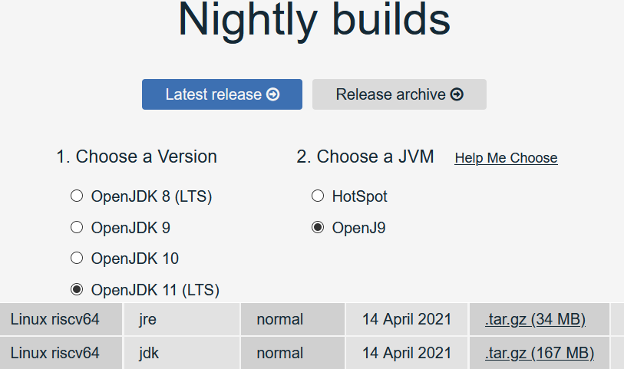
Downloading link of nightly builds at AdoptOpenJDK (Adoptium)
https://adoptopenjdk.net/nightly.html?variant=openjdk11&jvmVariant=openj9
How to cross-compile OpenJ9/RISC-V ?
https://github.com/eclipse/openj9/blob/master/doc/build-instructions/Build_Instructions_V11.md#riscv64
Want to get involved in the RISC-V project?
https://openj9.slack.com/ (channel #risc-v)

Slide 19
Q & A

